Slide 1

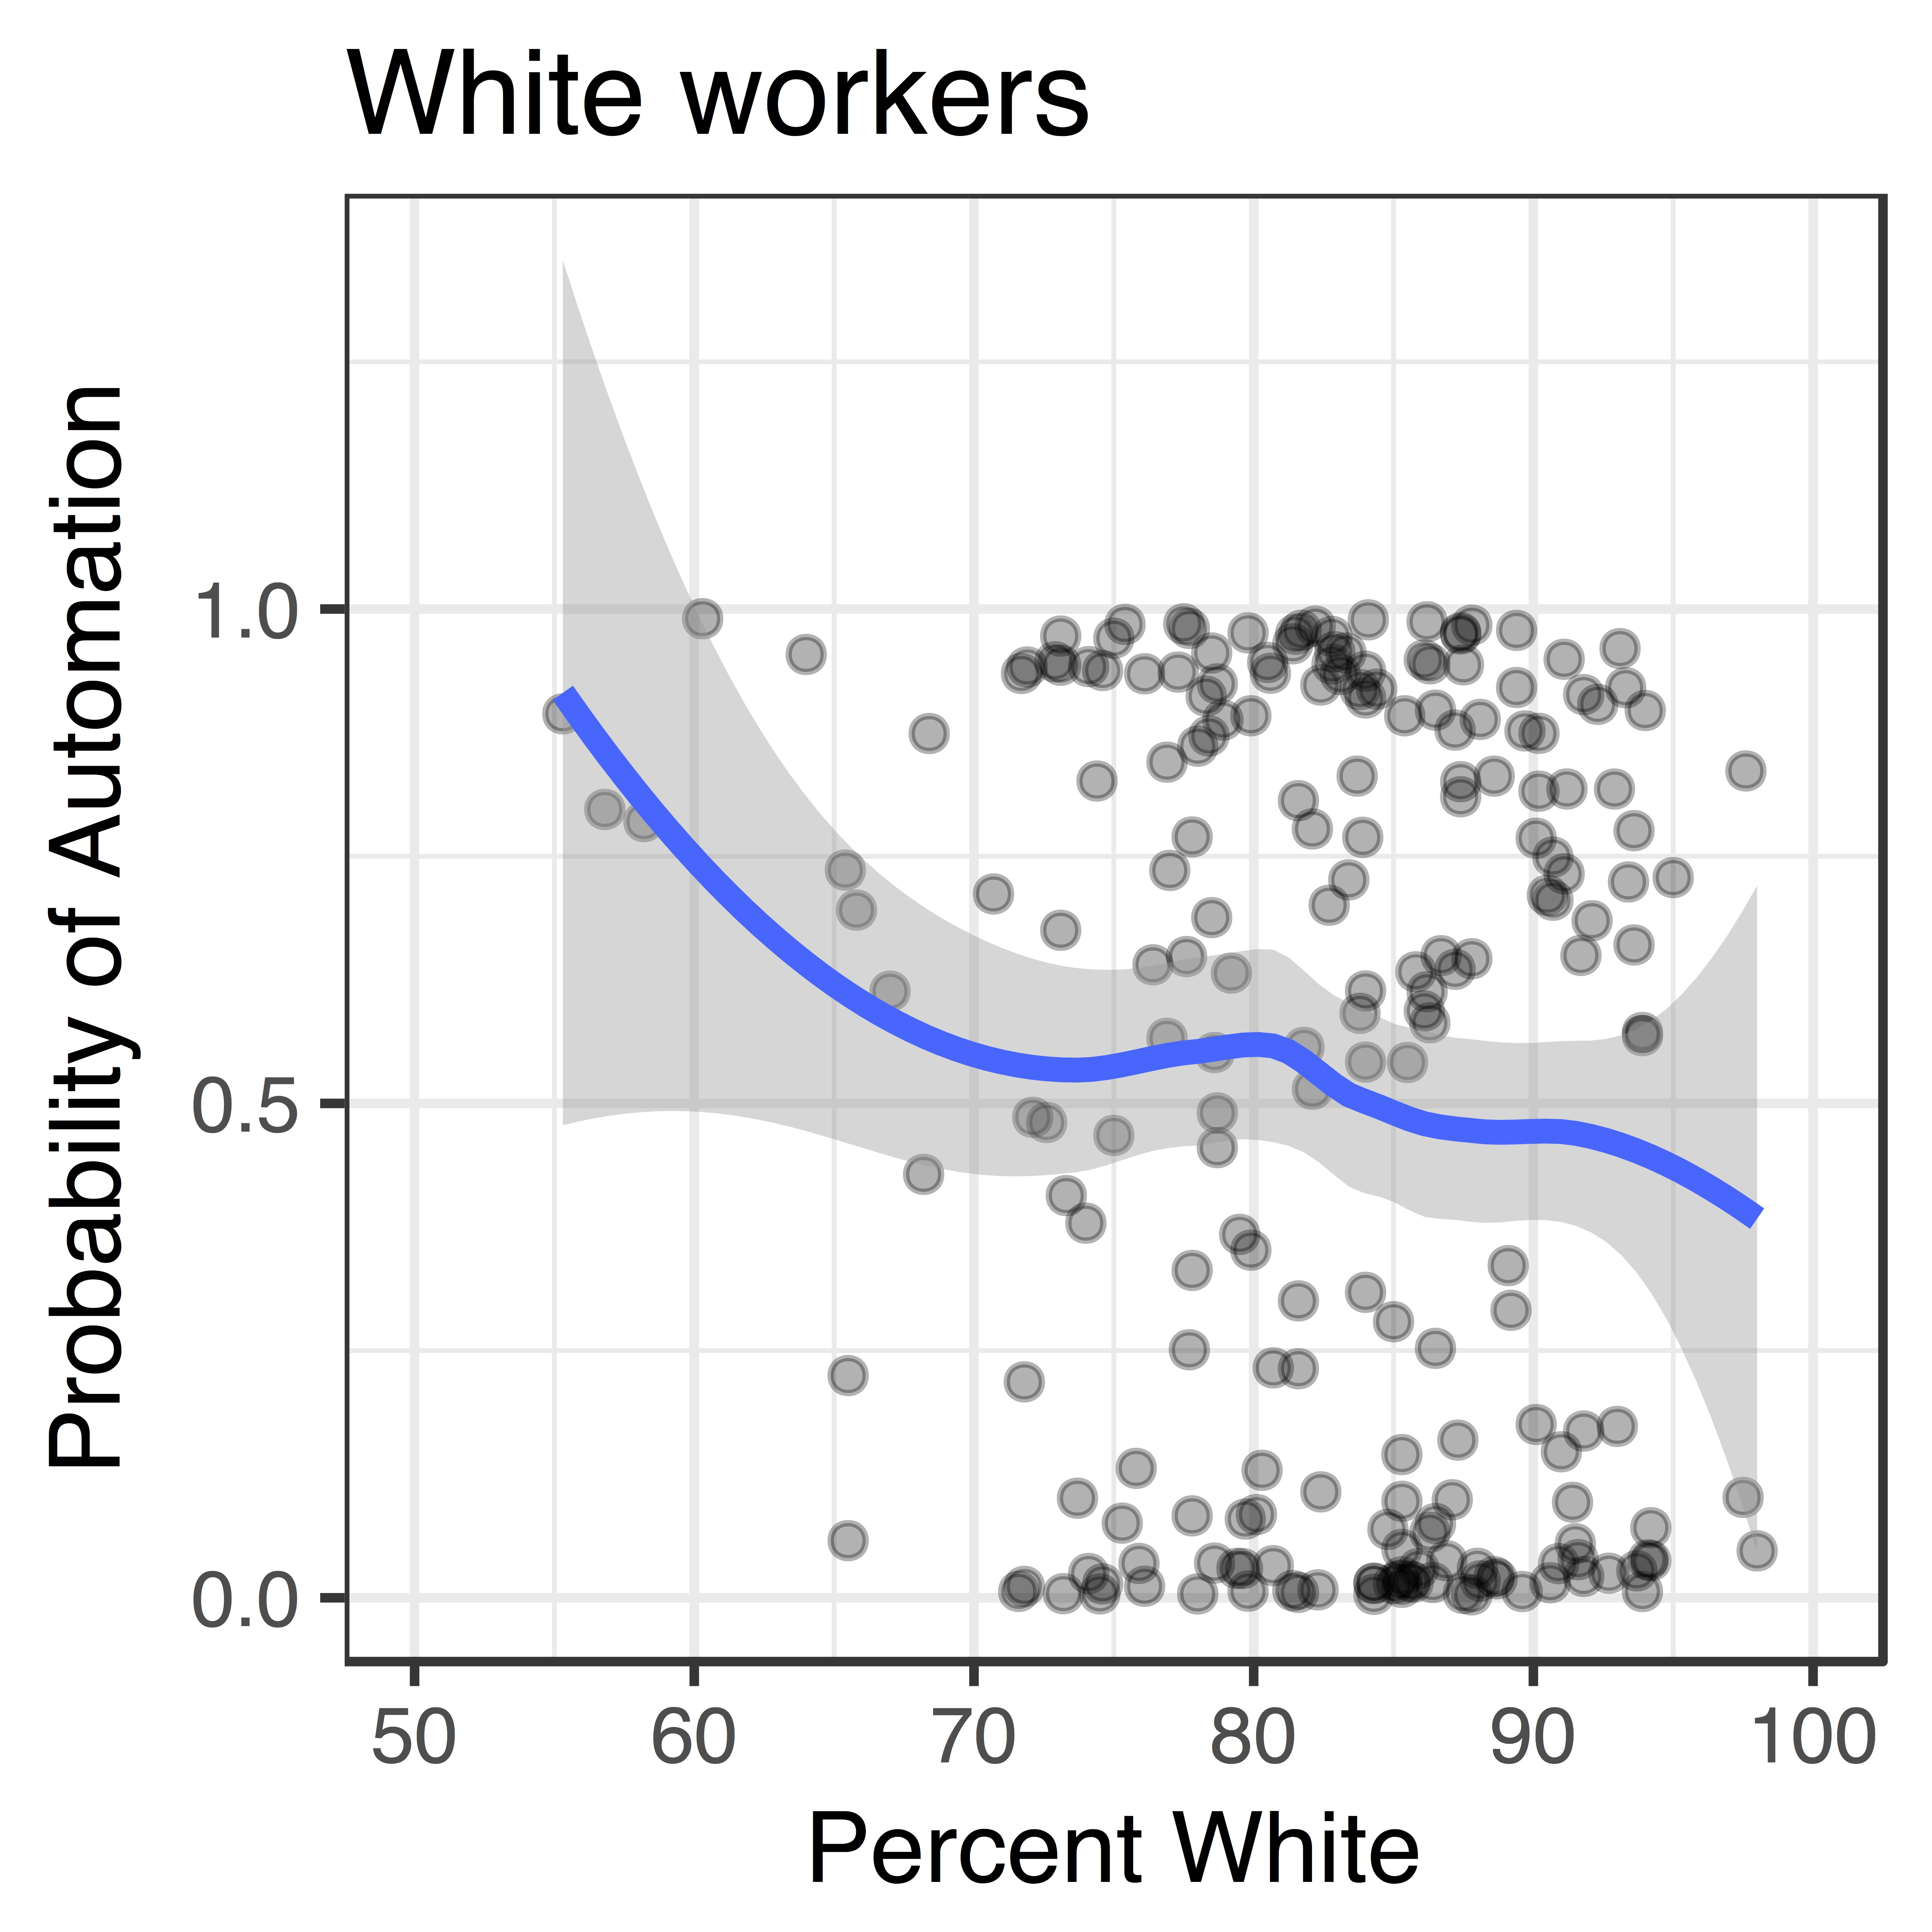

RACE, ETHNICITY, AND THE FUTURE OF WORK
Pegah Moradi
Department of Government, Cornell University, Ithaca, NY
Context
Discussion
Two competing narratives dominate the discussion of race and workplace automation: Jobs that are supposedly more automatable are manufacturing roles largely occupied by white workers, yet low-skill occupations where minority workers are overrepresented may also be highly susceptible to automation.
The findings of this study support both competing narratives on race and automation under different frames of reference: Within an occupation, these findings support the argument that minority representation in an occupation correlates negatively with automatability.
The findings that white workers in the aggregate are more affected by occupational automation offers some support for the generalization of the distressed white working class.
A prevailing explanation for the competing results is that white workers may simply be overrepresented in several highly populated and highly automatable occupations, while minority workers may be overrepresented in smaller but still highly automatable occupations.
Research Questions
What is the relationship between occupational automatability and race and ethnicity?
To what extent will occupational automation affect workers of different racial and ethnic demographics?
Methodology
Merged occupational automatability data from Professors Carl Frey and Michael Osborne of Oxford University with occupational demographic data from the Bureau of Labor Statistics.
Used a multiple regression model to determine correlations between intra-occupational demographics and automatability.
Developed variable to calculate the overall effect of automation on groups of workers by race and ethnicity.
Generated a predictive model for automatability by intra-occupational demographics.
Acknowledgements
I would like to thank Professor Sergio Garcia-Rios for overseeing and advising the study, as well as Professors Jamila Michener and Karen Levy for their support during the development of the project. Additional thanks to Professor Michael Osborne of Oxford University for providing access to the datasets from his 2013 study with Professor Carl Frey.
Results
Automation affects white workers significantly more than minority workers when accounting for population
As the proportion of black and Hispanic/Latino workers within an occupation increases, the predicted automatability of that occupation increases.

